Slide 1

SDLC The Agile Framework
Presentation by Caitlyn Walsh

Slide 2
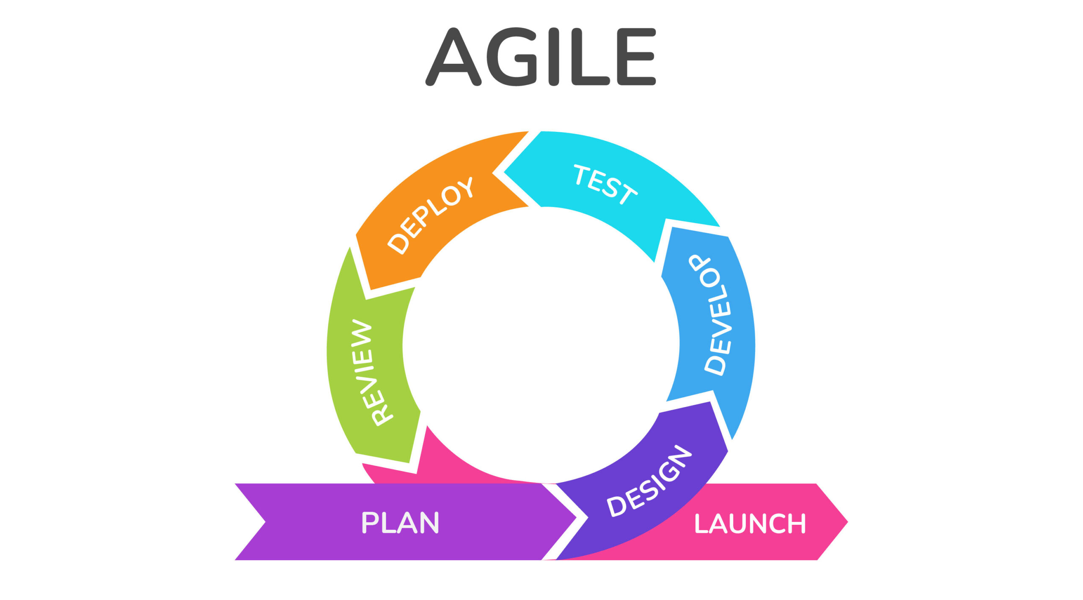
– Agile – What is it?
Agile is a type of Software Development Life Cycle (SDLC) framework that takes an alternate and effective approach to software development.
Agile is versatile, and aligned to deliver changing business requirements and distributes software with faster and fewer changes. Source: Agile Methodology – Javatpoint
Agile is a wildly adopted practice across the industry since it was popularized in 2001, with Scrum being the most popular implementation. Source: History of Agile Methodology: How it was Developed (knowledgehut.com)

Slide 3

The Scrum Team
As an intimate team typically consisting of 10 people or fewer, the Scrum Team consists of:
The Product Owner
The Scrum Master
The Development Team
Every Scrum Team member plays an important role for creating a valuable, useful Increment with every sprint.
Sources: What is a Scrum Team? | Scrum.org

Slide 4
– SCRUM Team – The Product Owner
The core communicator between the client and the Scrum Team.
Responsible for developing the Product Goal and creating and communicating Product Backlog items.
Responsible for effectively communicating the product’s vision, the product’s value, purpose, goals, and direction to the rest of the Scrum Team.
Sources: The Product Owner | Scrum.org

Slide 5
– Scrum team – The Scrum Master
The coach that holds the Scrum Team accountable for following standard practices of Scrum, along with taking a back-seat approach to center the development team.
Responsible for facilitating important Scrum Events such as Sprint Planning, Daily Scrums, Backlog Refinement, and Sprint Reviews and Retrospectives.
Communicates between the Product Owner and the Development Team to effectively plan the Product Goal and Backlog.
Sources: The Scrum Master | Scrum.org

Slide 6
– Scrum team – The Development Team
Responsible for the product design and engineering.
Prioritizes technical excellence as well as industry standard best coding practices for high product quality.
Developers
Works closely with the developers to perform quality testing of the product.
Designs and executes testing plans and cases to continuously improve the product with the developers.
Testers

Slide 7
– Agile – The SDLC Phases
PLAN:
The Product Owner determines the scope of the project by discussing key requirements with the client to create the Product Goal.
DESIGN:
The Scrum development team begins the initial design process of the project, such as a mock-up version of the software’s design to display.
DEVELOP:
The development team begins programming the software and constructing the required features.
TEST:
Before the software is ready to deploy, it must be tested rigorously to assess its quality, and to find any unexpected bugs.
DEPLOY:
After testing, the software is then released into production.
REVIEW:
The project is then presented to the client and stakeholders to showcase the product. Any suggestions could start another sprint for the project.
LAUNCH:
Once the project satisfies the requirements, it is ready to be launched as a product, and maintenance of the product will presume.
Source: The Agile Software Development Life Cycle | Wrike Agile Guide

Slide 8
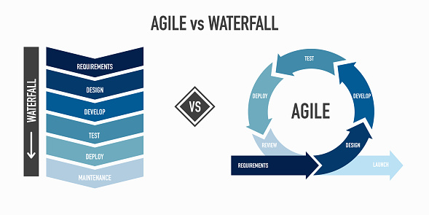
Is it worth the change?

Slide 9
– Waterfall vs. agile – what is the best choice?
WATERFALL
Just like a downhill stream, the Waterfall methodology is a linear flow of progression with each phase going down the completed list.
Any changes or errors are all expected to be seen within the planning phase of development, leading to any changes within the design or developing phases significantly holding back the flow of production.
Based on the linear nature of Waterfall, it is an SDLC method that is best used for products with little to no user interaction, such as factory machinery.
Sudden changes or feedback can risk project failure.
AGILE
The nature of Agile is a continuous and progressive flow of development, involving a rigorous practice of communication between the clients, stakeholders, and the development team.
Agile is designed to incorporate changes at any point of the development phase, and it rarely interrupts project flow.
It is best suited for products that requires end user interaction, such as web development.
Agile relies heavily on communication and collaboration. If there is no open communication or a team environment, the project risks failure.

Slide 10

Our Experience
SNHU Travel, our client, has been an important factor with testing the Agile framework in action. Because the client’s product is a website, Agile was the best approach for development.
As expected in designing a website, SNHU Travel had changing plans for how they wanted their website to look within the middle of the development sprint.
If Waterfall was used in this design method, the project would have taken longer to deploy, and would have risked failure due to the rigid structure of the Waterfall method. This would have led to customer dissatisfaction, and potentially higher costs.
With the Agile approach, the website was able to be deployed on time, with little interruptions to the project flow.
Due to this, SNHU Travel has received a working and well-designed website and are overall satisfied with the product.

Slide 11

Final Thoughts
What methodology would be the best choice to incorporate for ChadaTech?
What aspects of Waterfall are working currently, and what could be improved by Agile?
Feel free to ask any questions!

Slide 12
Sources
Agile methodology - javatpoint. www.javatpoint.com. (n.d.). https://www.javatpoint.com/agile
Quick, L. (2024, February 19). History of agile methodology: How it was developed. KnowledgeHut. https://www.knowledgehut.com/blog/agile/history-of-agile
What is a scrum team? Scrum.org. (n.d.). https://www.scrum.org/resources/what-scrum-team
The product owner. Scrum.org. (n.d.-a). https://www.scrum.org/learning-series/product-owner/what-is-a-product-owner-
The Agile Software Development Life Cycle: Wrike Agile Guide. Versatile & Robust Project Management Software. (n.d.). https://www.wrike.com/agile-guide/agile-development-life-cycle/

